Slide 1

Verifiable, Tamper-Proof Academic Records for Uganda
Team members:
SSEKIZIYIVU PAUL
KYOTOYINZE ABDUL MAJIID SHABAN
BALAMAGA EXPERITO
MUDEBO SAMUSI
NABASIRYE SEANICE
EduChain
PU
Notes:
1

Slide 2

The Problem: Dreams Shattered by Fraud
Rampant Certificate Forgery
In Uganda, fake transcripts and forged certificates have become a growing epidemic, destroying the credibility of our education system.
Slow, Manual Verification
Current verification processes are painfully slow and manual, causing delays that cost students opportunities and jobs.
Lost Documents & Opportunities
Paper documents are frequently lost or damaged, leaving graduates unable to prove their qualifications and fulfill their potential.
Notes:
2

Slide 3
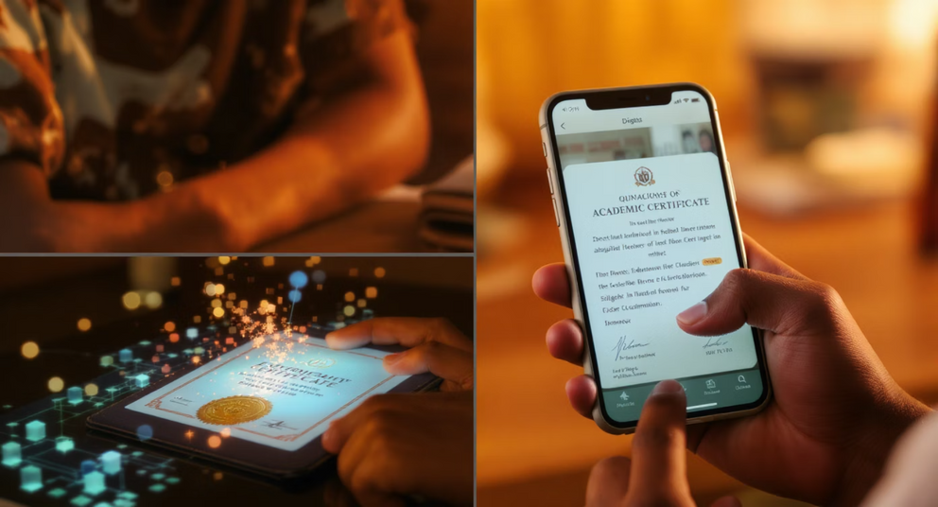
Our Solution: Restoring Trust Through Technology
Our project is a blockchain-based solution that uses Non-Fungible Tokens (NFTs) to issue secure, tamper-proof academic certificates. Built on the Base blockchain, it allows Ugandan institutions to mint each certificate as a unique NFT, with student data (name, course, grades, date) recorded immutably on-chain.
The full certificate is stored securely on the InterPlanetary File System (IPFS), and students receive their records directly into their digital wallets. This gives them full ownership and provides a reliable, digital alternative to paper documents that are often lost, delayed, or forged.
Notes:
3

Slide 4




Transforming Lives Through Verification
Instant Verification
Building Trust
National Impact
Employers, universities, and agencies can instantly confirm a certificate's authenticity by checking the NFT on the Base blockchain — no need to call or write to institutions.
This builds trust, reduces fraud, and supports national goals like digital transformation and transparent service delivery.
In Uganda, where fake transcripts and forged certificates are a growing problem, our project introduces a fast, trustless verification system.
Our project can also be extended to include report cards, transcripts, and other academic records, all verifiable and accessible online.
Notes:
4

